Slide 1
Deep Learning for Natural Language Processing Lecture 4: Pre-trained Language Model
Quan Thanh Tho
Faculty of Computer Science and Engineering
Back Khoa University

Slide 2
Agenda
GPT-2 and what we have done
Practical Situation: Huge Data, Few Labeled
Language Model: General Architecture
Case Studies
GPT, Transformer and BERT

Slide 3
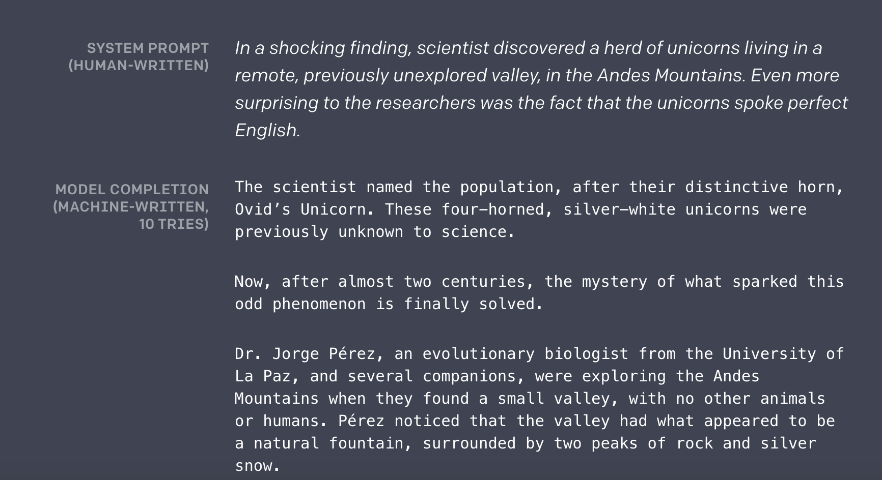

Slide 4
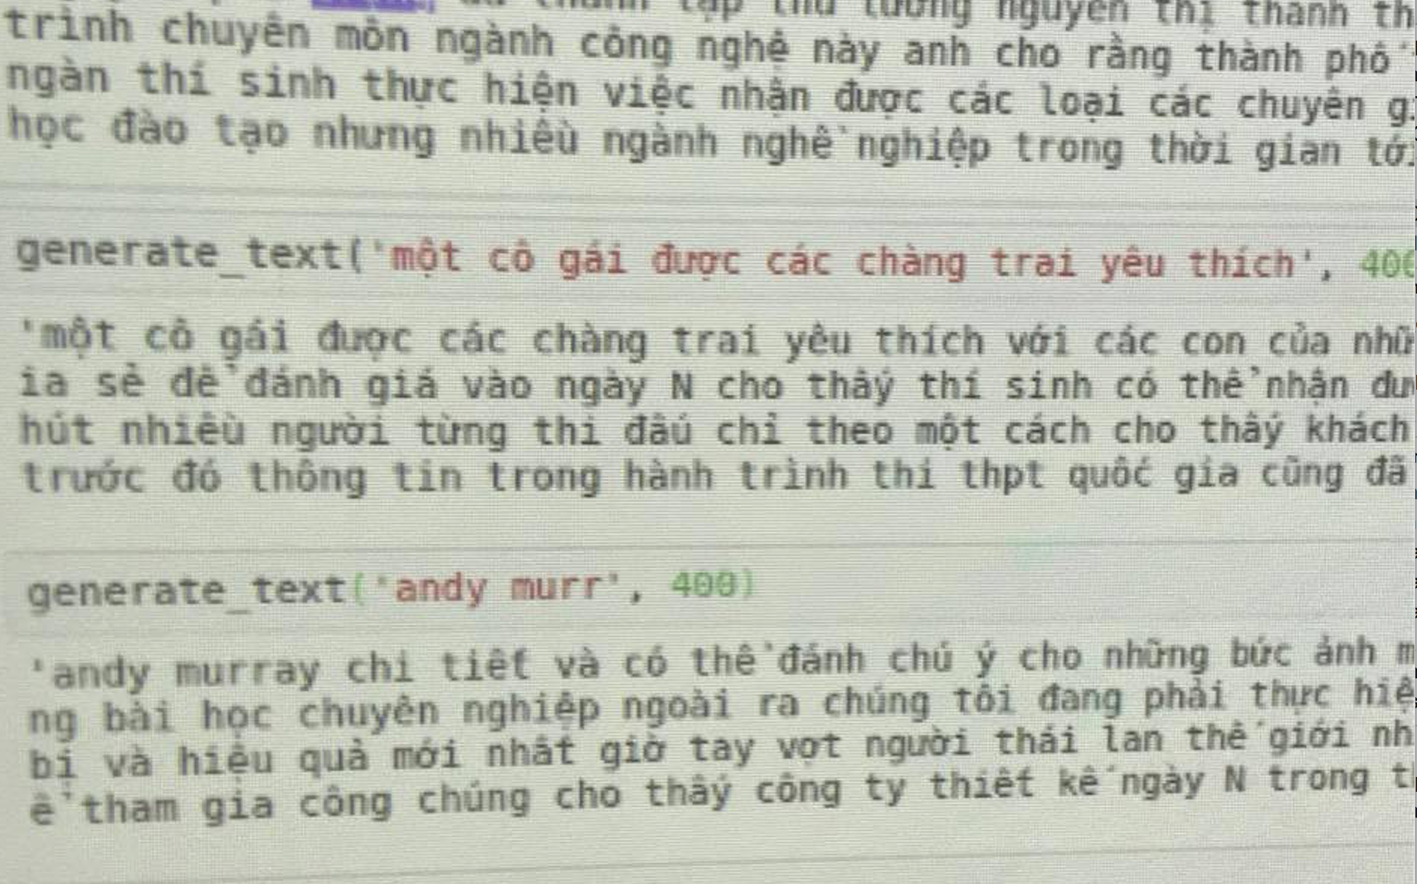

Slide 5
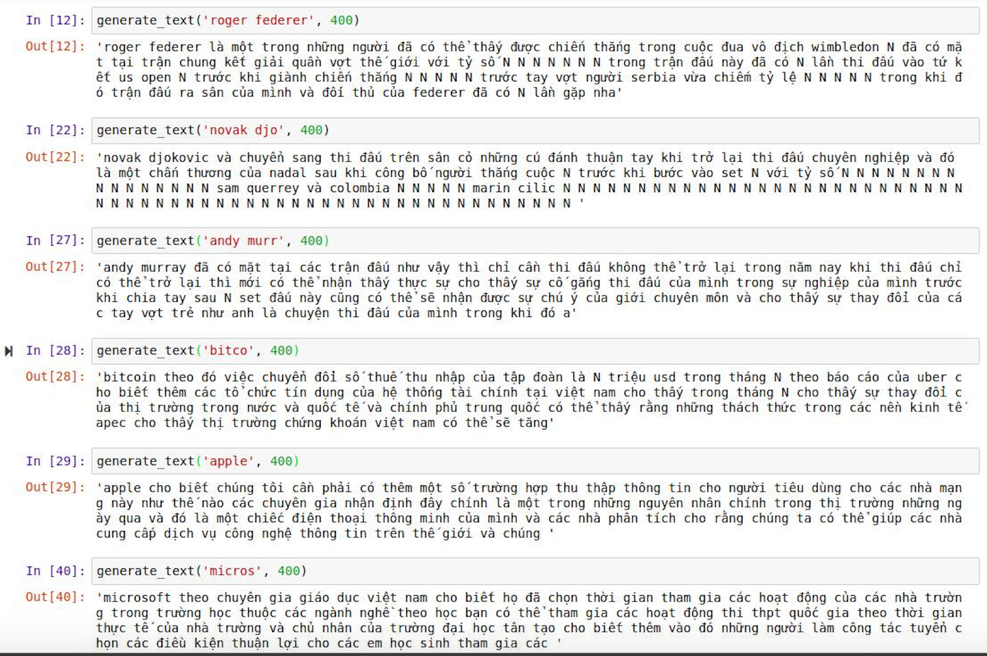

Slide 6
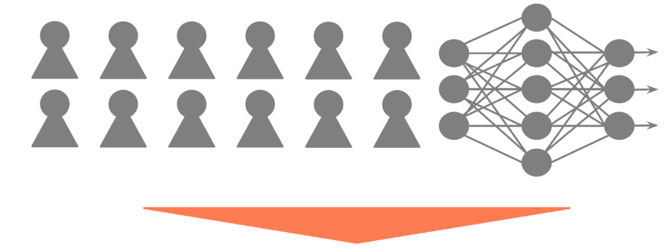
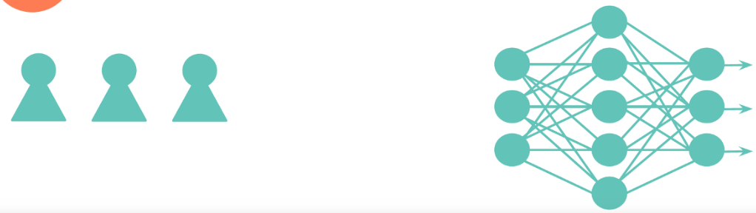
Introduction
Common situation at “big-data-based companies”
Cheap large dataset vs. expensive labeled data

Slide 7

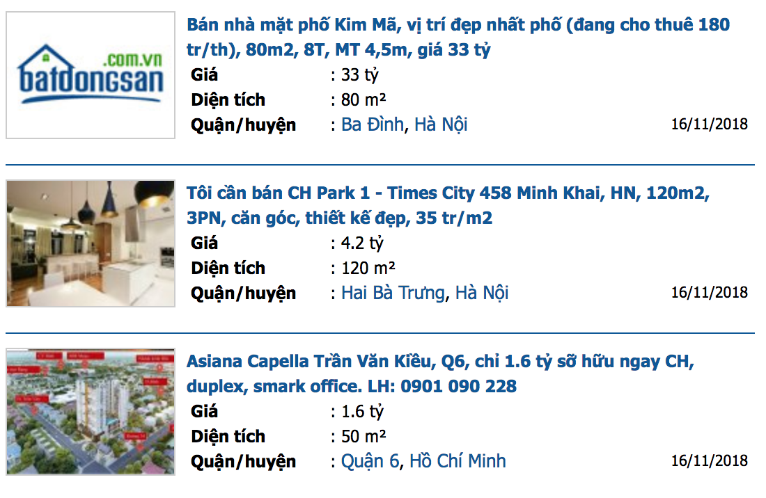

Slide 8
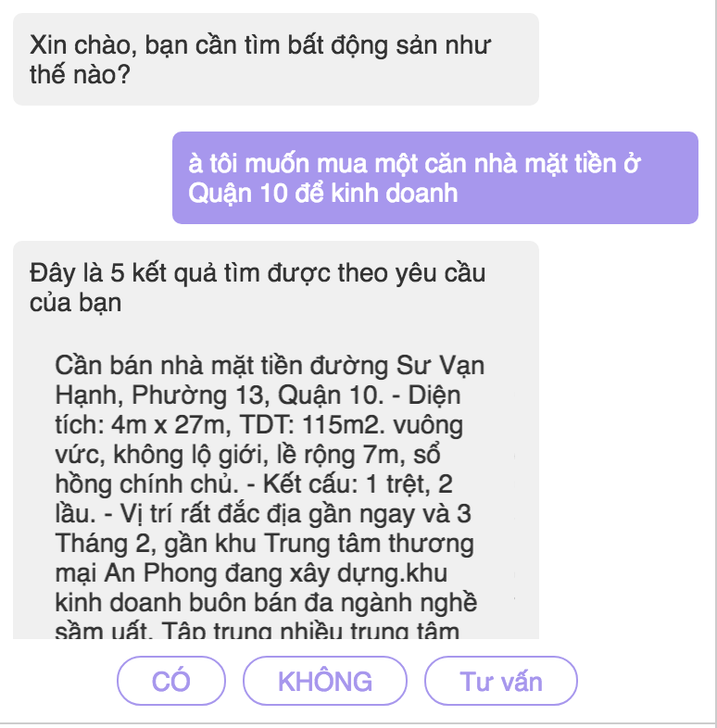

Slide 9
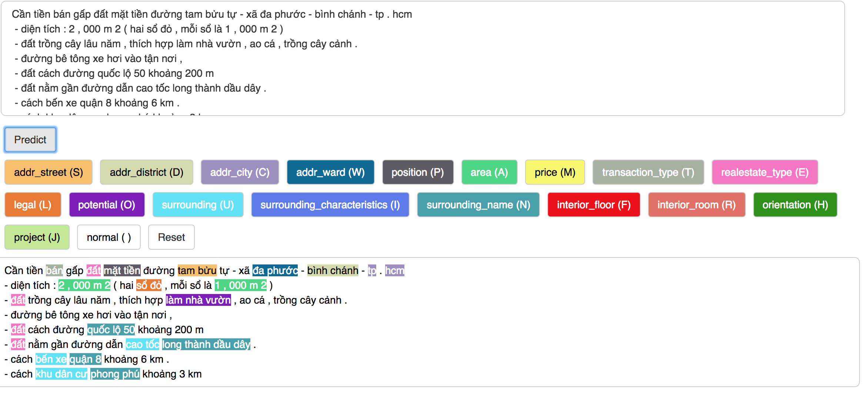

Slide 10
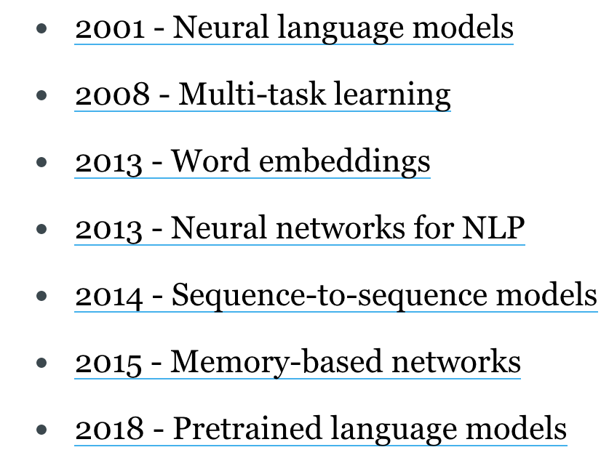
Neural-based Milestones for NLP
Character-based representations
Adversarial learning
Reinforcement learning
Conditional random fields
Bleu
Latent Dirichlet Allocation
Wikipedia exploitation

Slide 11
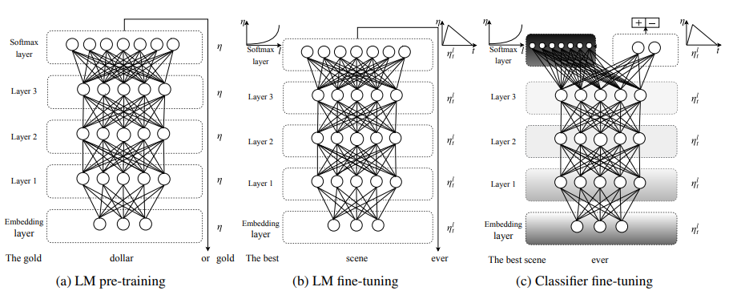
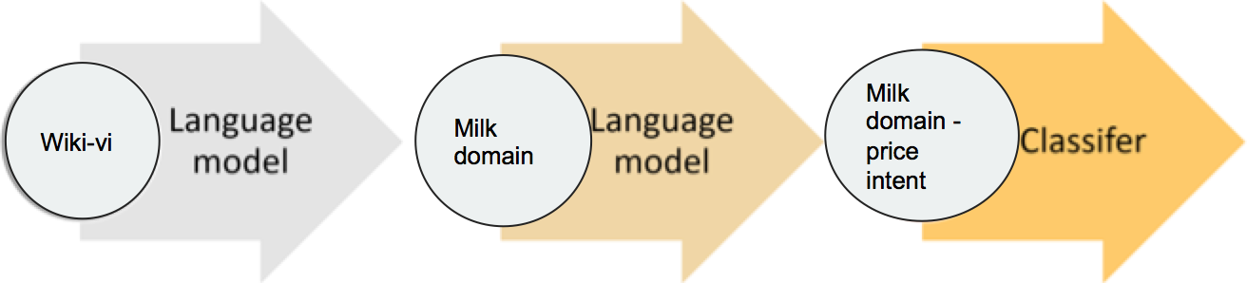
Pre-trained Neural Language Model

Slide 12
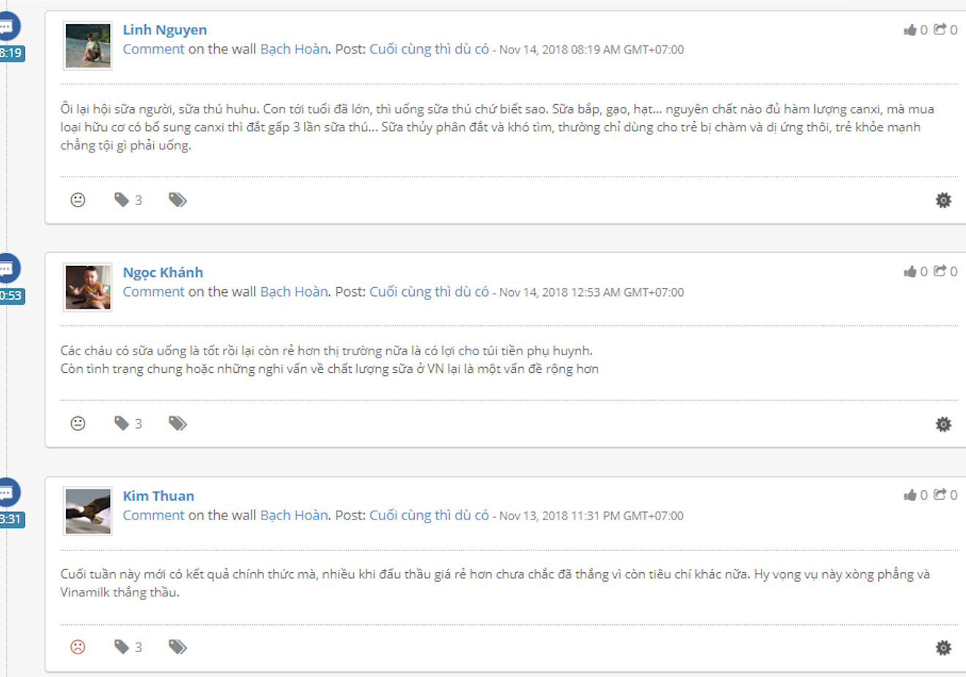

Slide 13
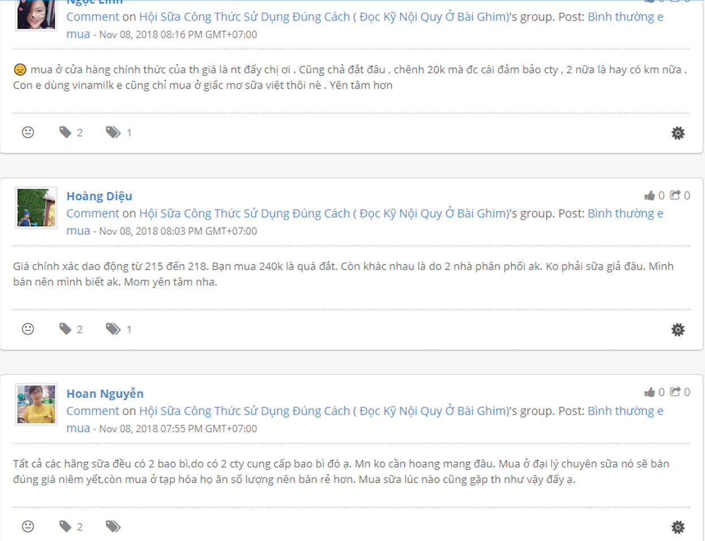

Slide 14
Intuition
Sua pediasure giá bnhju vay

Slide 15
Intuition
Sua pediasure giá bnhju vay --------------------
Cái này giá bao nhiêu vậy
Giá nó bao nhiêu
Bao nhiêu một hộp sữa vậy
Giá hộp sữa bao nhiêu
Giá hộp này bnhju
Bnhju thì bán được

Slide 16
Case Studies
Language model
Intent classification
NER tagging

Slide 17
BERT: Pre-training of Deep Bidirectional Transformers for Language Understanding​
Devlin et al., 2018 (Google AI Language)​
NLP course

Slide 18
Outline
Research context
Main ideas
BERT
Experiments
Conclusions

Slide 19
Research context
Language model pre-training has been used to improve many NLP tasks
ELMo (Peters et al., 2018)
OpenAI GPT (Radford et al., 2018)
ULMFit (Howard and Rudder, 2018)
Two existing strategies for applying pre-trained language representations to downstream tasks
Feature-based: include pre-trained representations as additional features (e.g., ELMo)
Fine-tunning: introduce task-specific parameters and fine-tune the pre-trained parameters (e.g., OpenAI GPT, ULMFit)

Slide 20
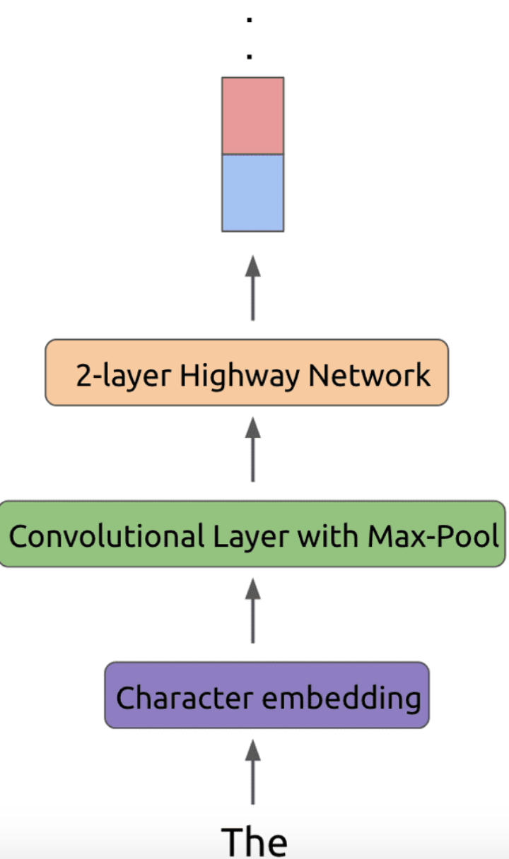
ELMO

Slide 21
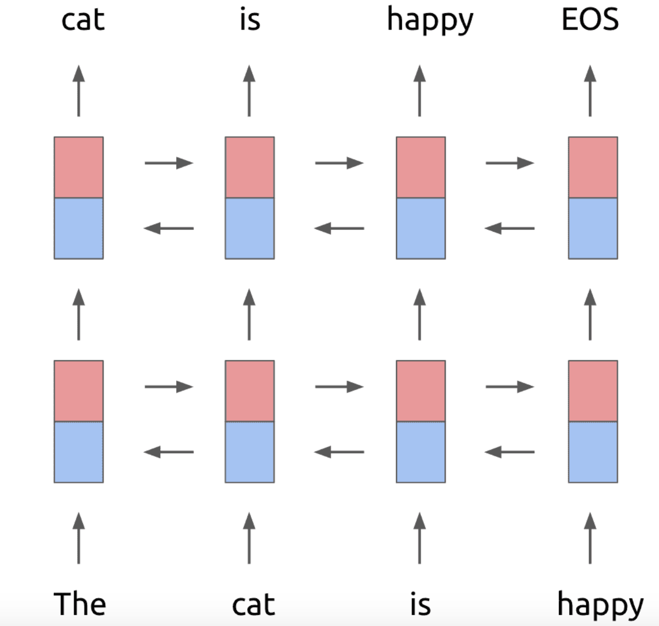

Slide 22
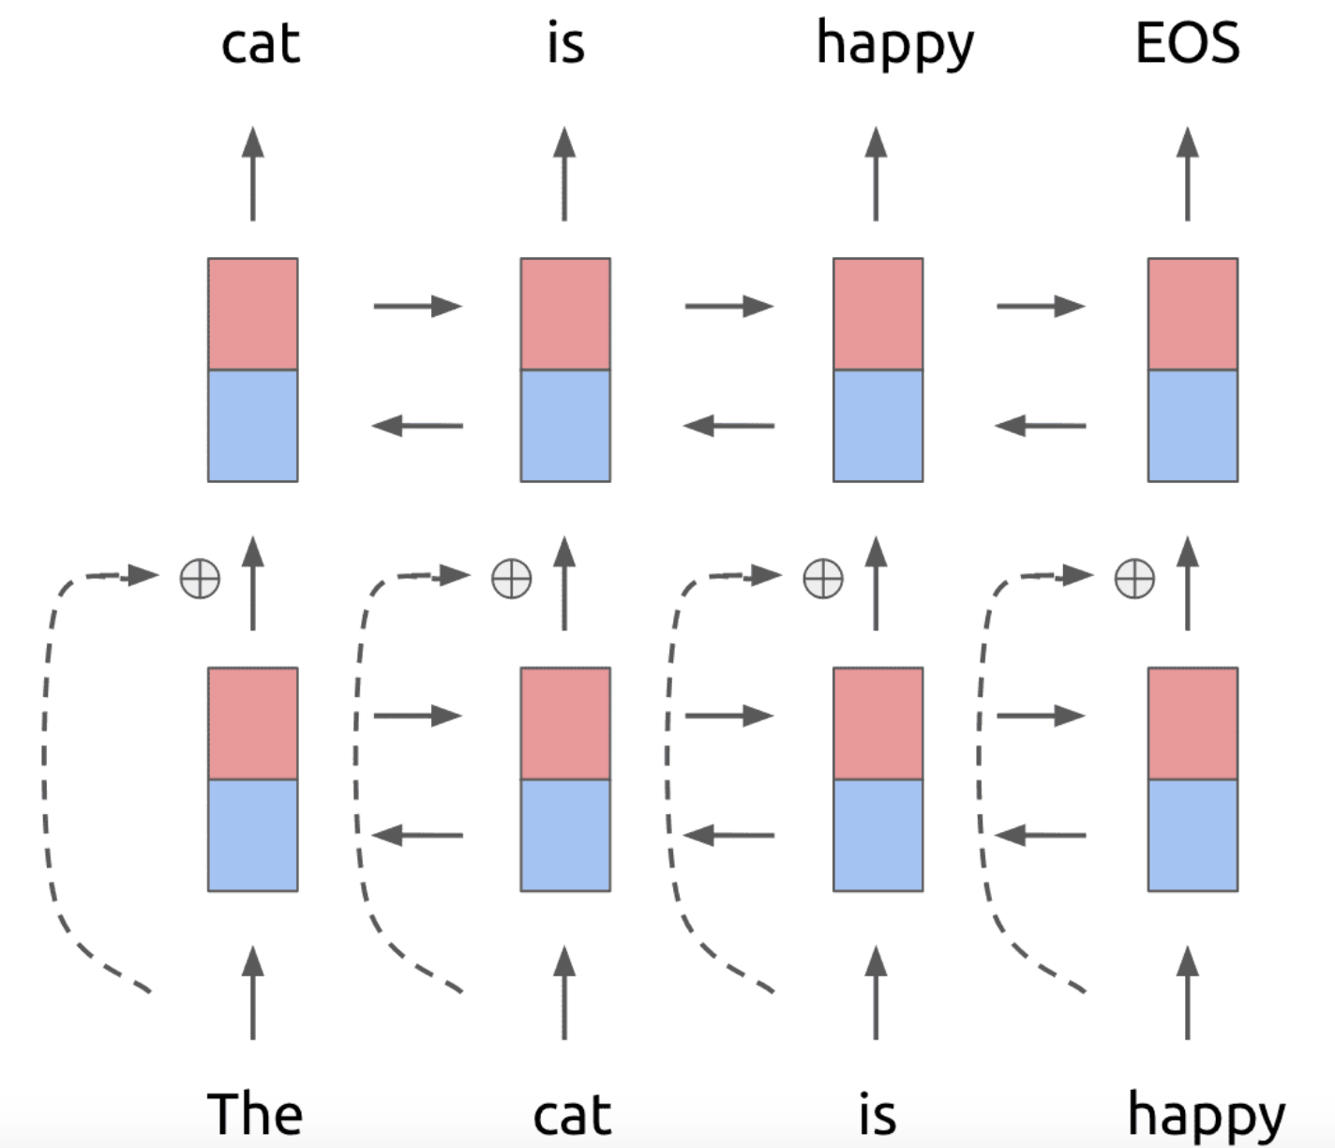

Slide 23
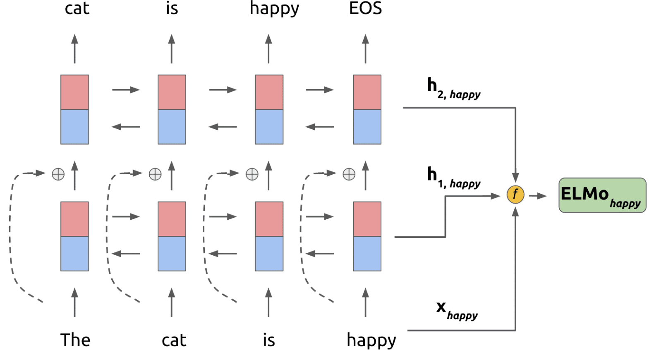

Slide 24
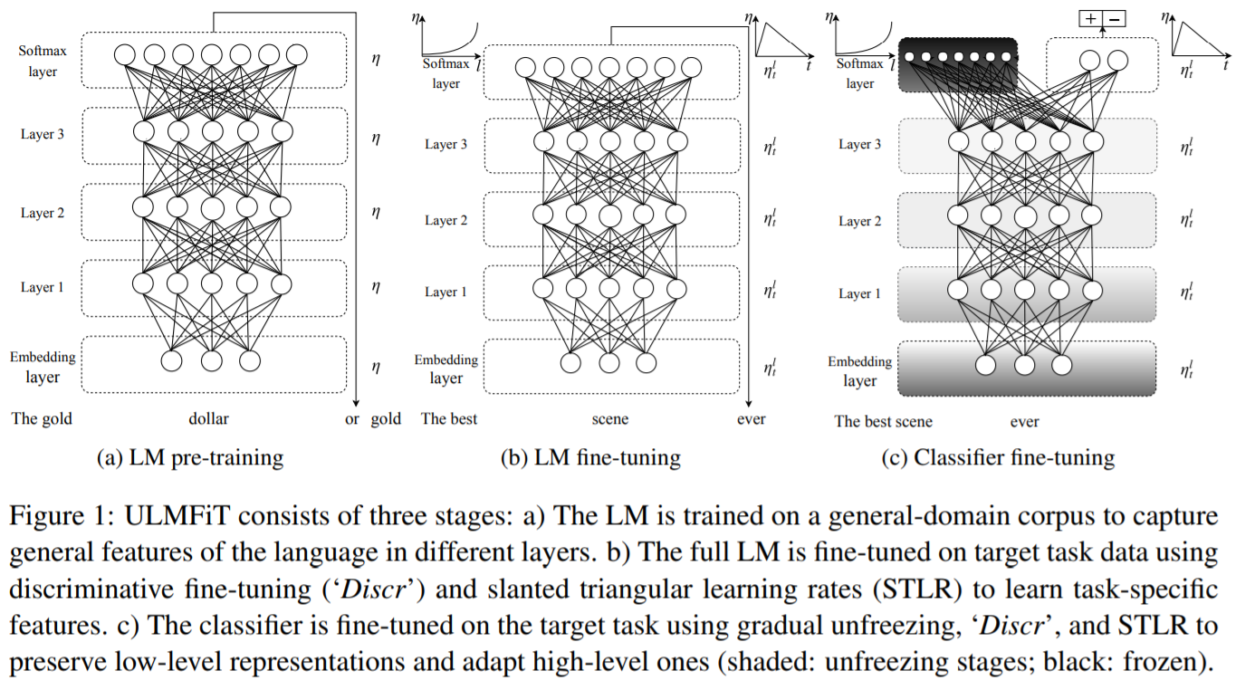
ULMFit

Slide 25
Limitations of current techniques
Language models in pre-training are unidirectional, they restrict the power of the pre-trained representations
OpenAI GPT used left-to-right architecture
ELMo concatenates forward and backward language models
Solution BERT: Bidirectional Encoder Representations from Transformers

Slide 26
BERT: Bidirectional Encoder Representations from Transformers
Main ideas
Propose a new pre-training objective so that a deep bidirectional Transformer can be trained
The “masked language model” (MLM): the objective is to predict the original word of a masked word based only on its context
”Next sentence prediction”
Merits of BERT
Just fine-tune BERT model for specific tasks to achieve state-of-the-art performance
BERT advances the state-of-the-art for eleven NLP tasks

Slide 27
BERT: Bidirectional Encoder Representations from Transformers

Slide 28
Model architecture
BERT’s model architecture is a multi-layer
bidirectional Transformer encoder
(Vaswani et al., 2017) “Attention is all you need”
Two models with different sizes were investigated
BERT_{BASE}: L=12, H=768, A=12, Total Parameters=110M
(L: number of layers (Transformer blocks), H is the hidden size,
A: the number of self-attention heads)
BERT_{LARGE}: L=24, H=1024, A=16, Total Parameters=340M

Slide 29
Differences in pre-training model architectures: BERT, OpenAI GPT, and ELMo

Slide 30
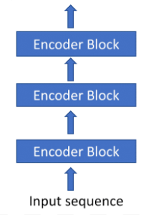
Transformer Encoders
Vaswani et al. (2017) Attention is all you need
Transformer is an attention-based architecture for NLP
Transformer composed of two parts: Encoding
component and Decoding component
BERT is a multi-layer bidirectional Transformer encoder

Slide 31
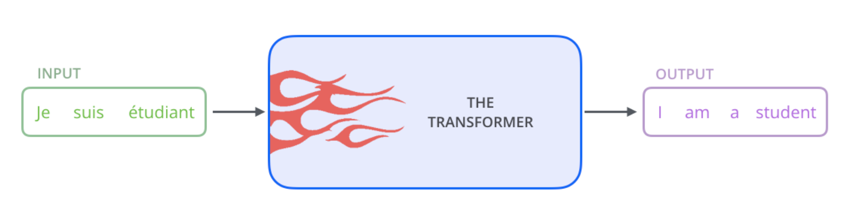
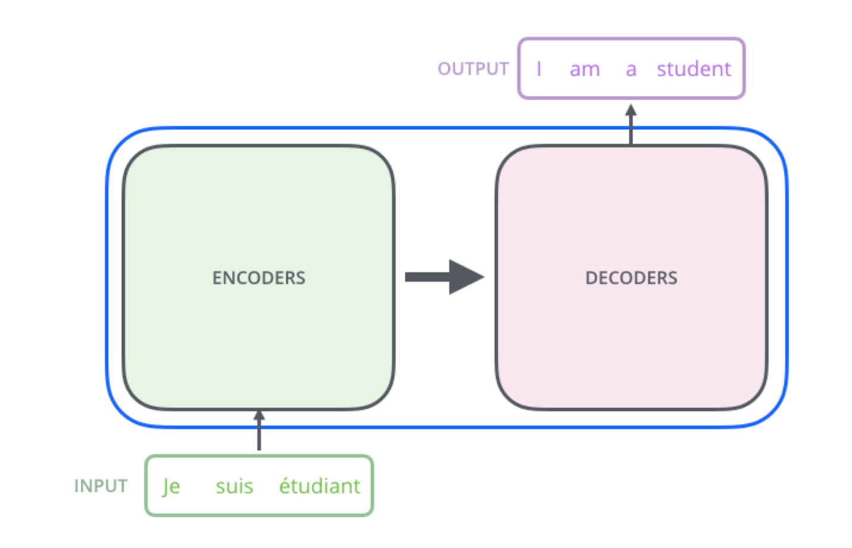

Slide 32
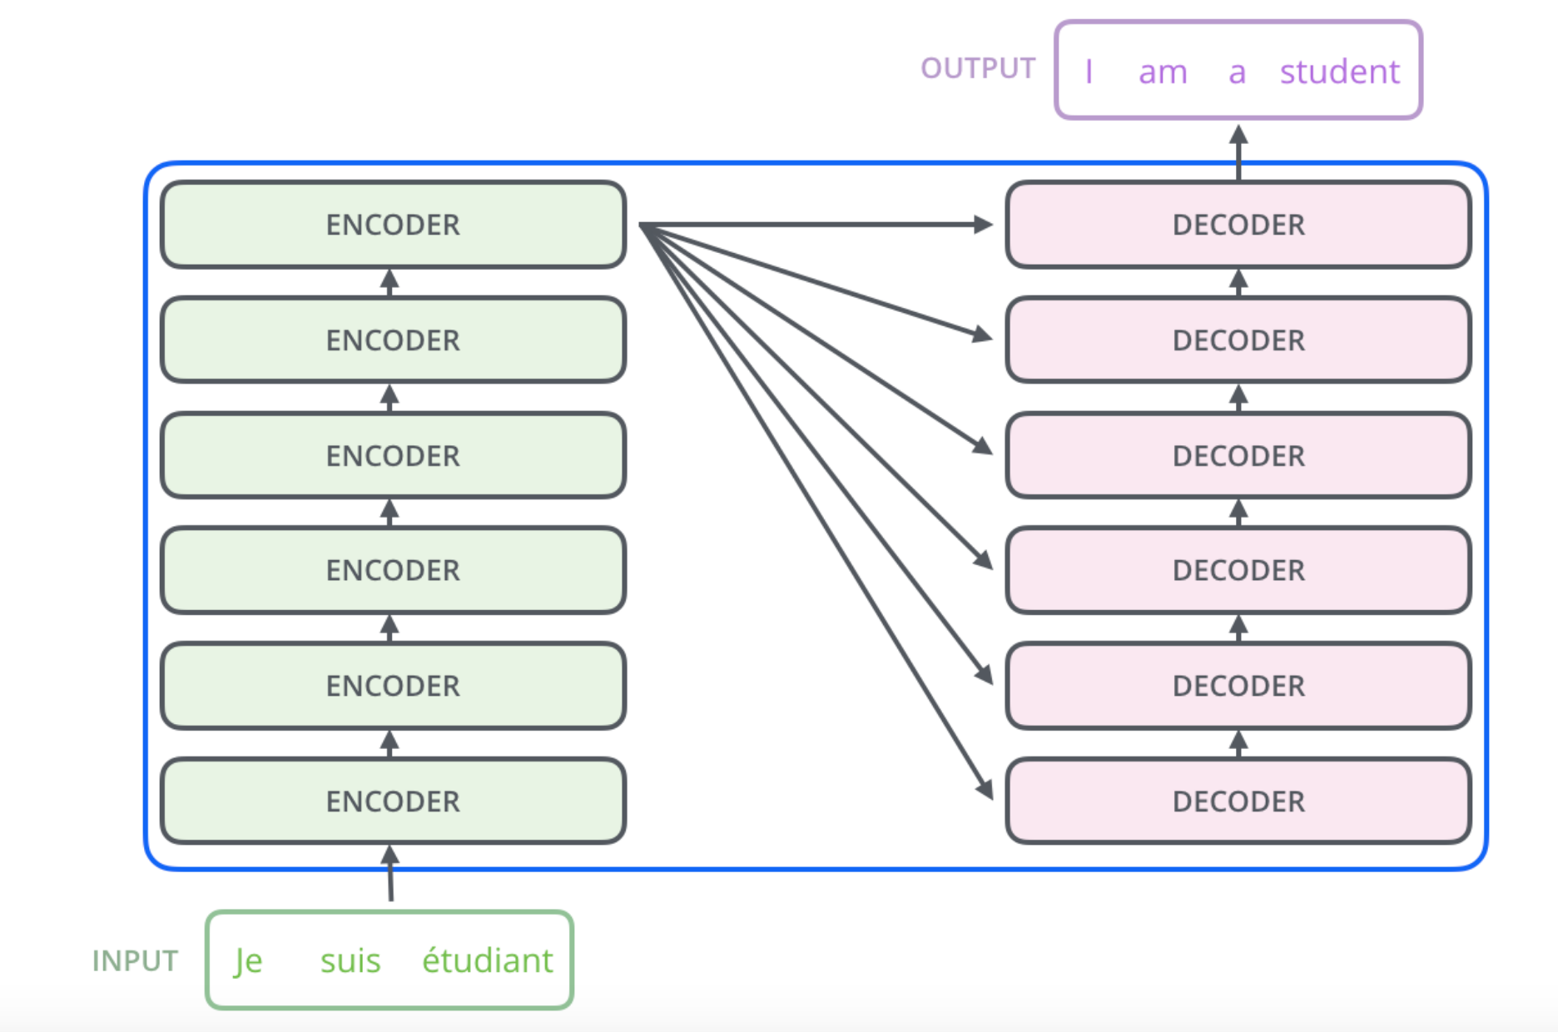

Slide 33
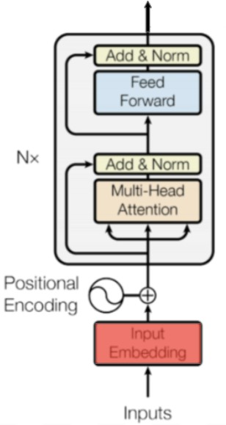
Inside an Encoder Block
In BERT experiments, the number of blocks N was chosen to be 12 and 24.
Blocks do not share weights with each other
Source: https://medium.com/dissecting- bert/dissecting-bert-part-1-d3c3d495cdb3

Slide 34
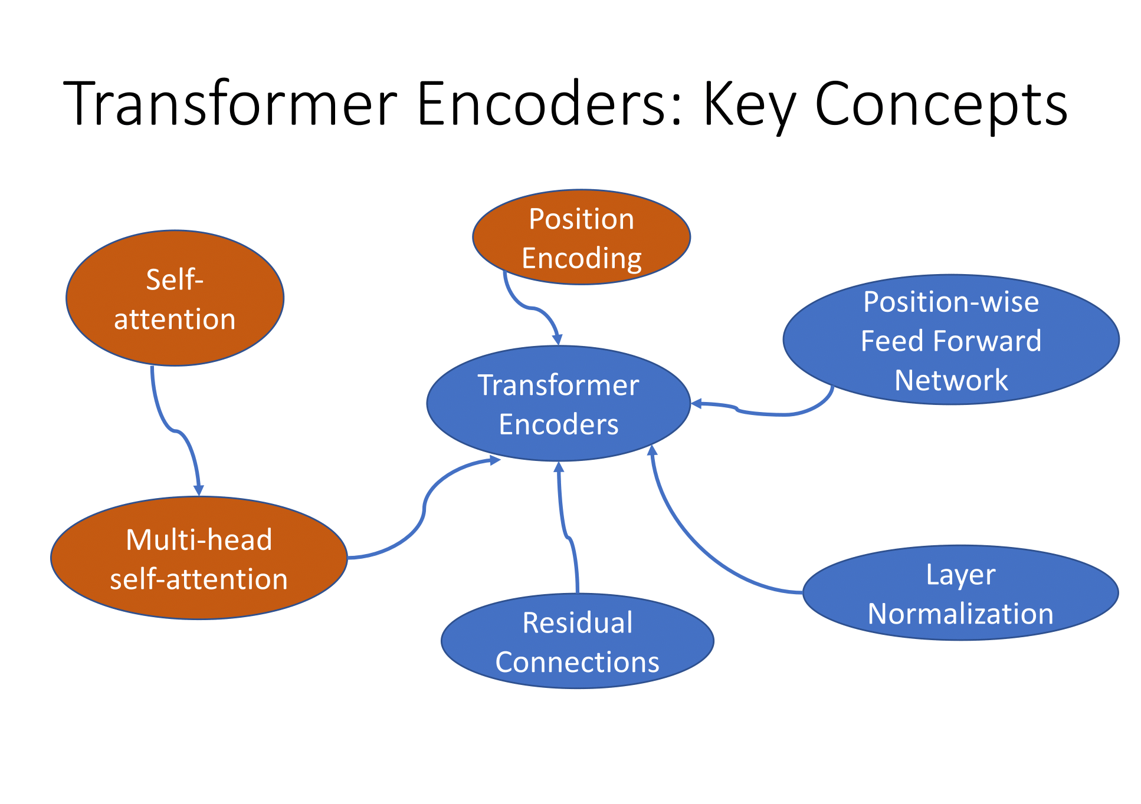

Slide 35
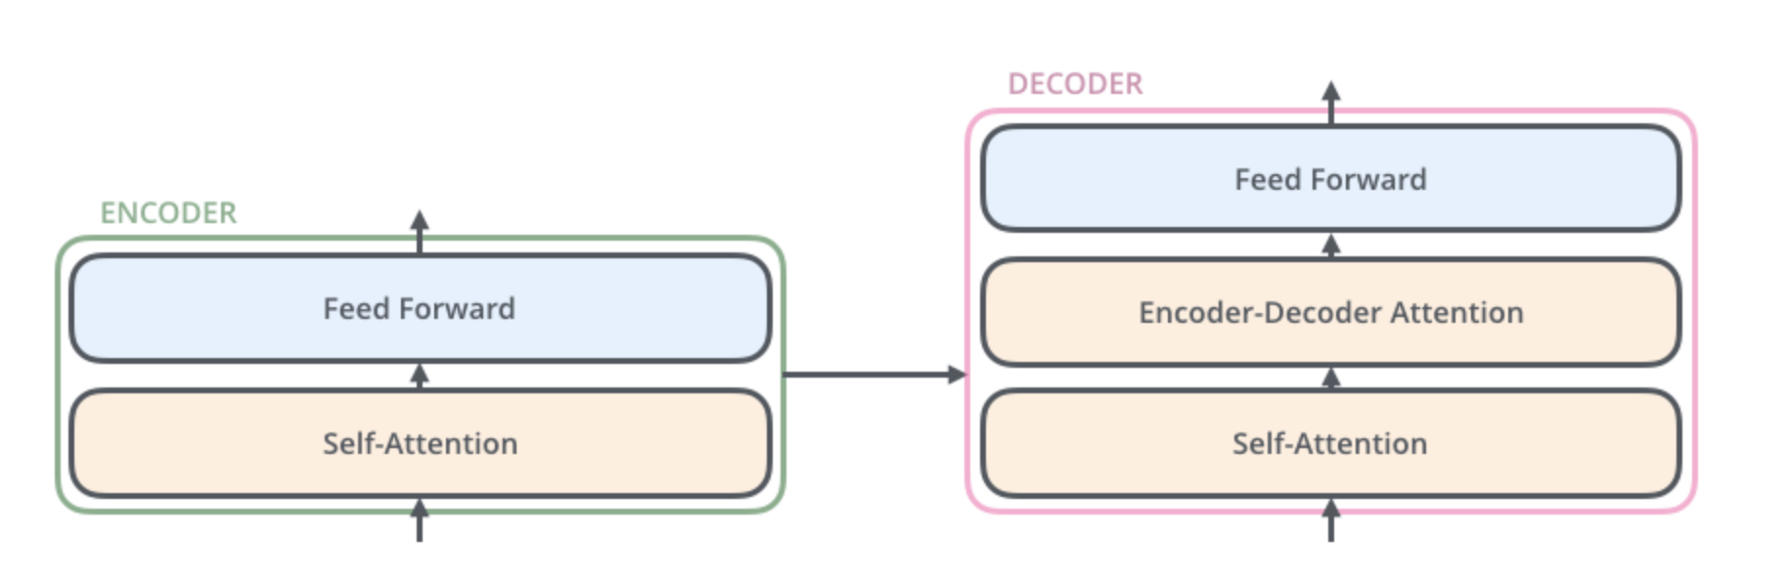

Slide 36
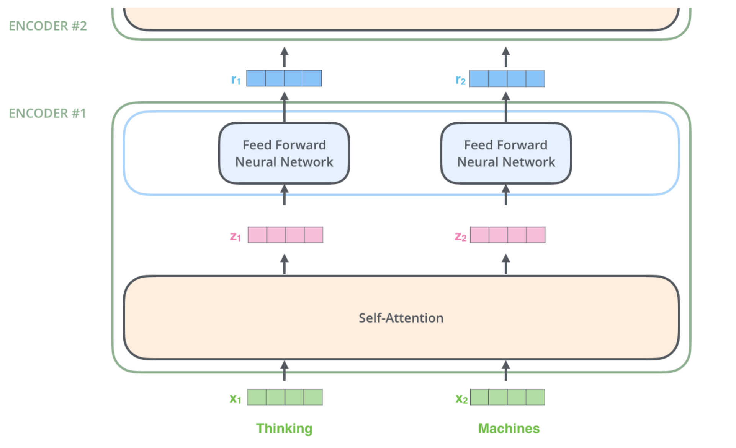

Slide 37
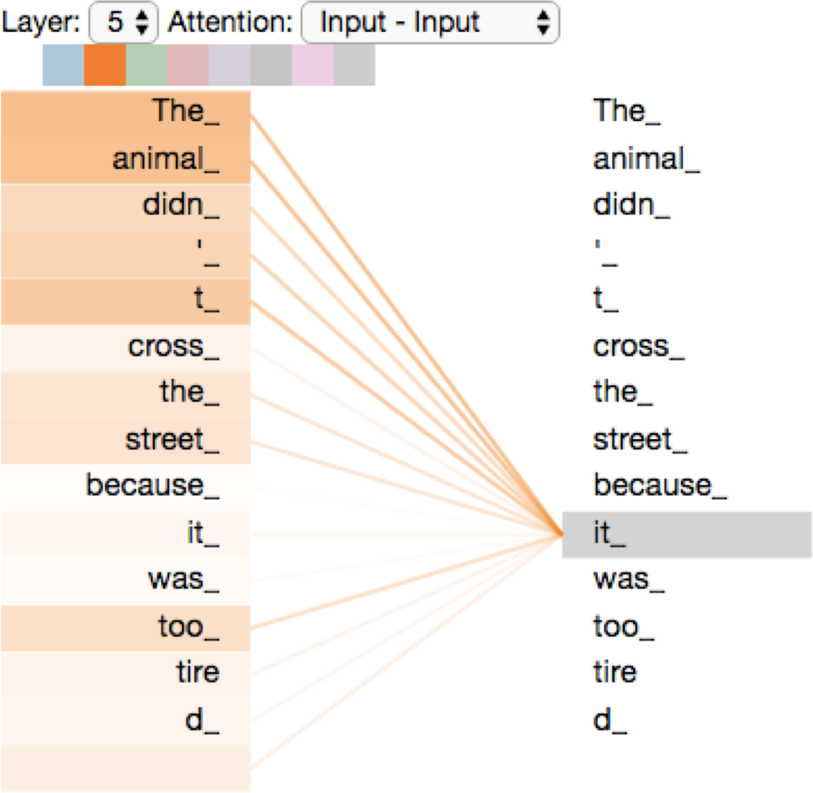
Self-Attention
Image source: https://jalammar.github.io/illustrated-transformer/

Slide 38
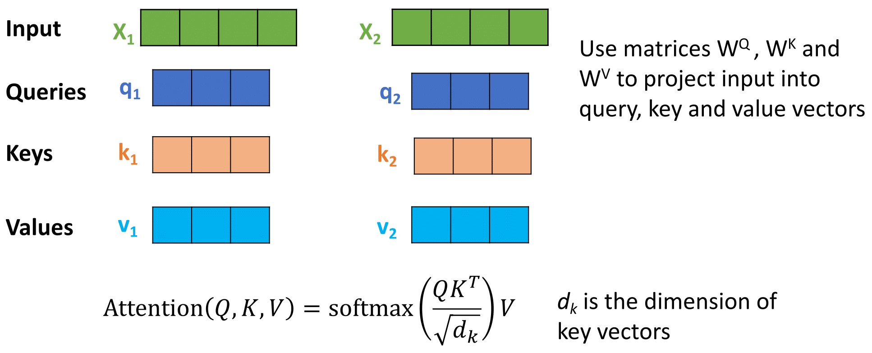
Self-Attention in Detail
Attention maps a query and a set of key-value pairs to an output
query, keys, and output are all vectors

Slide 39


Slide 40
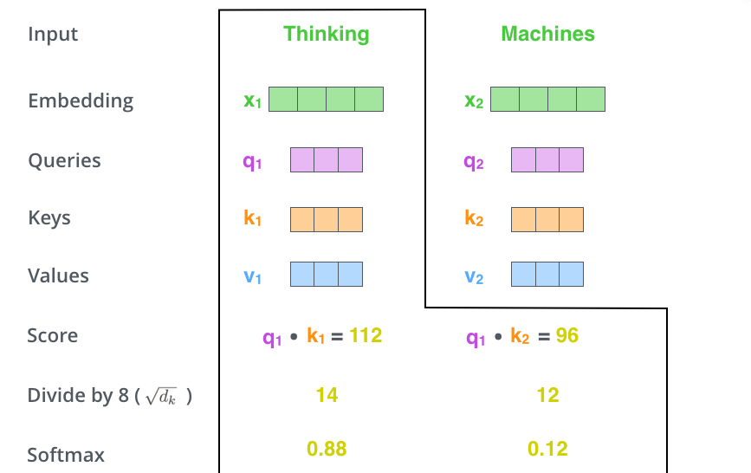

Slide 41


Slide 42
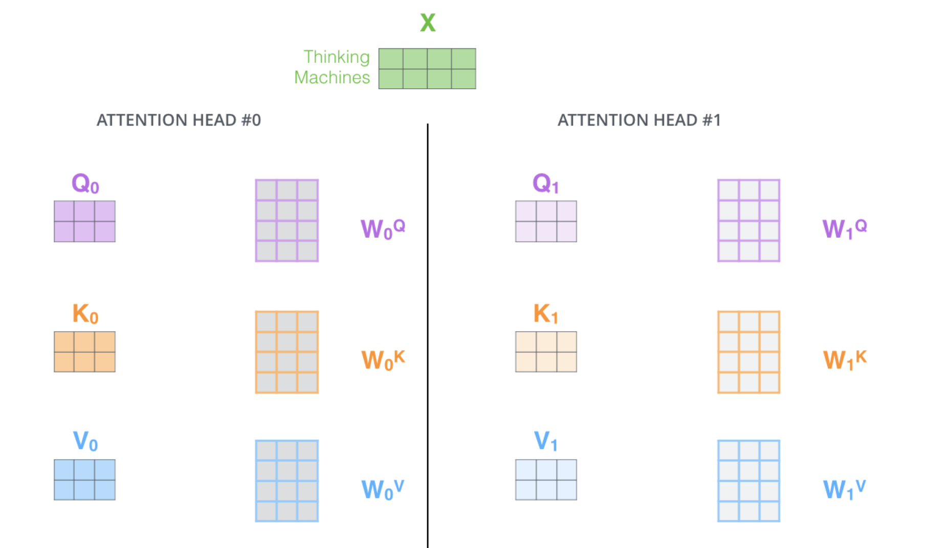

Slide 43
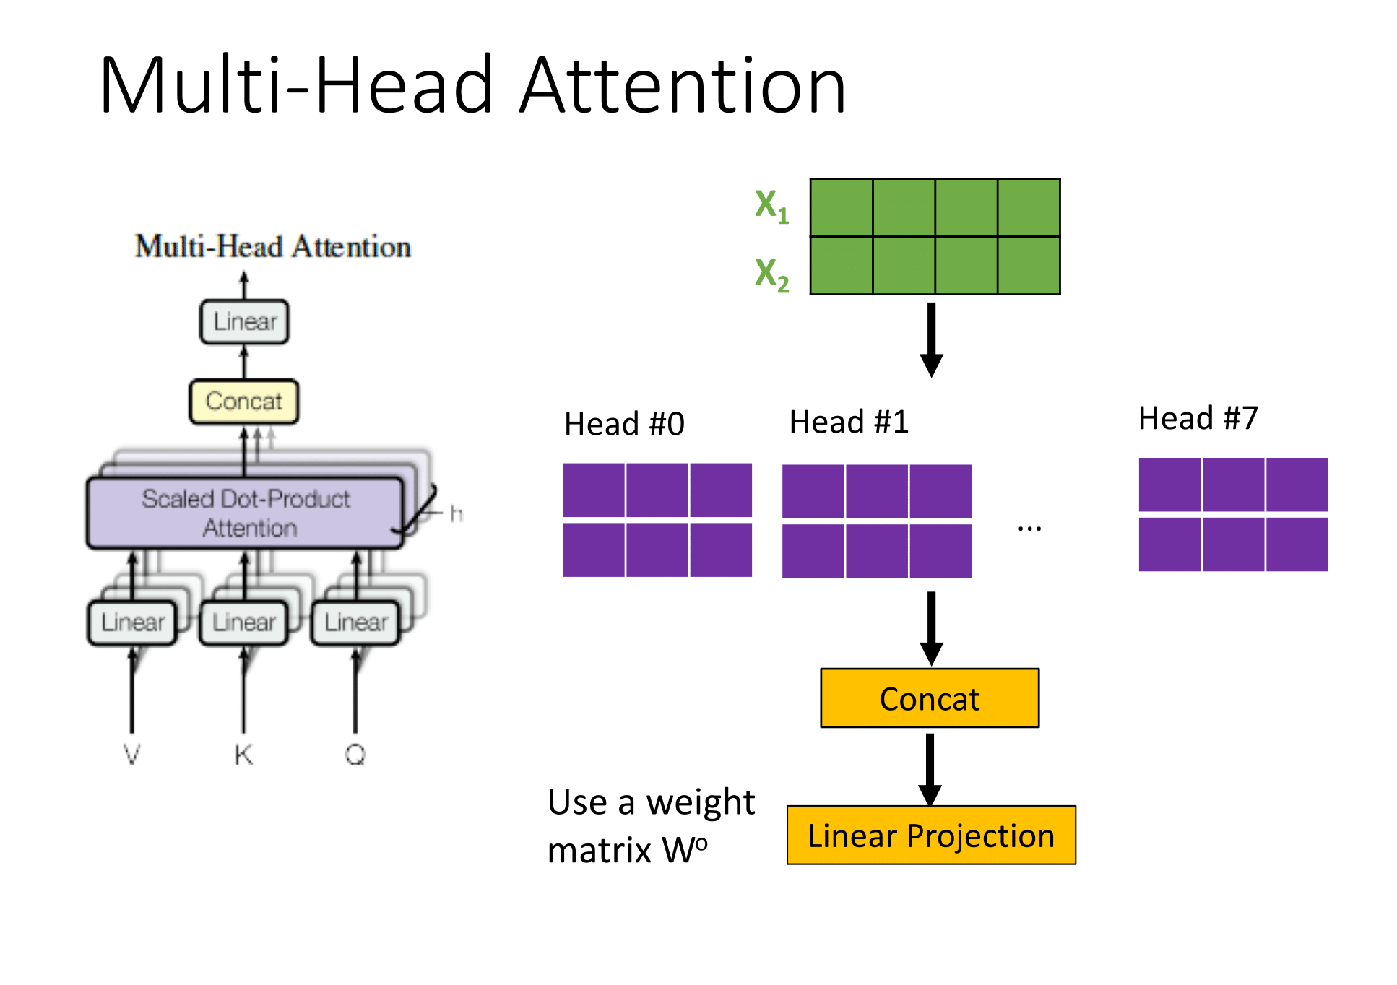

Slide 44
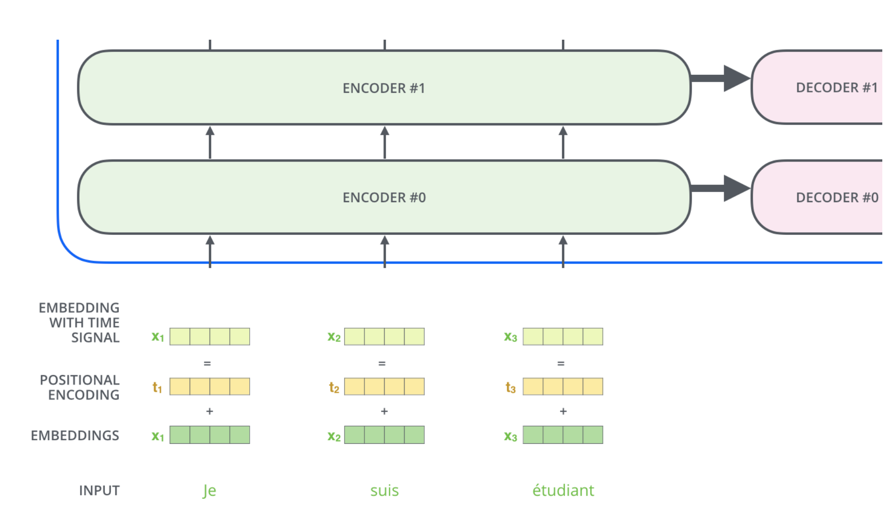

Slide 45
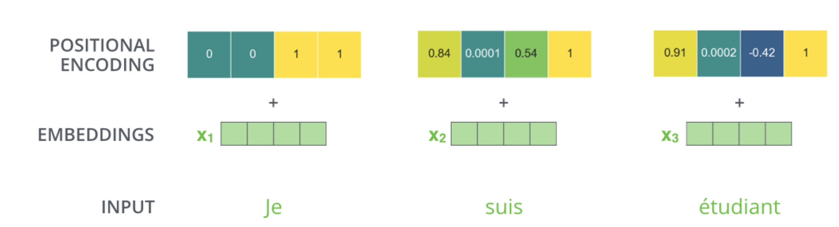

Slide 46
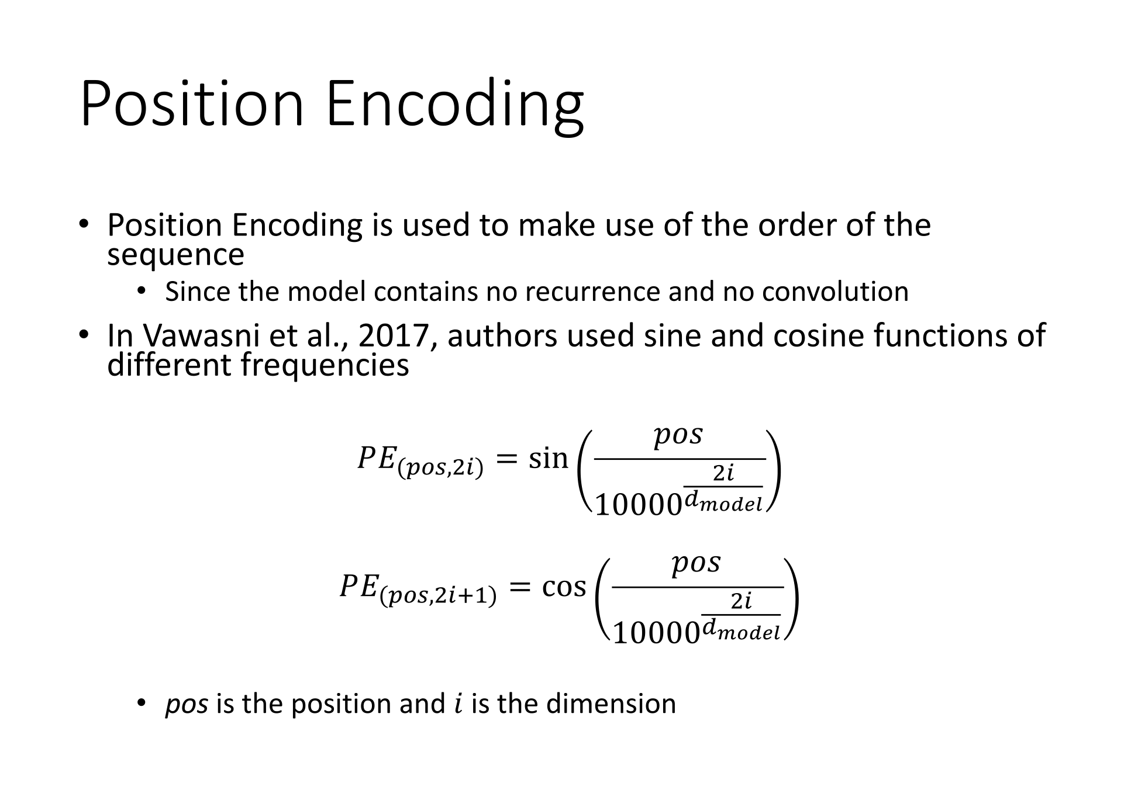

Slide 47
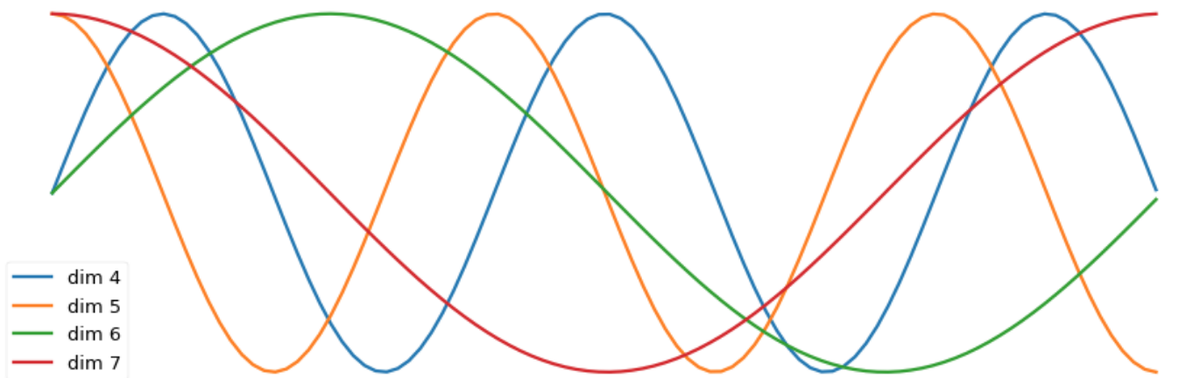

Slide 48
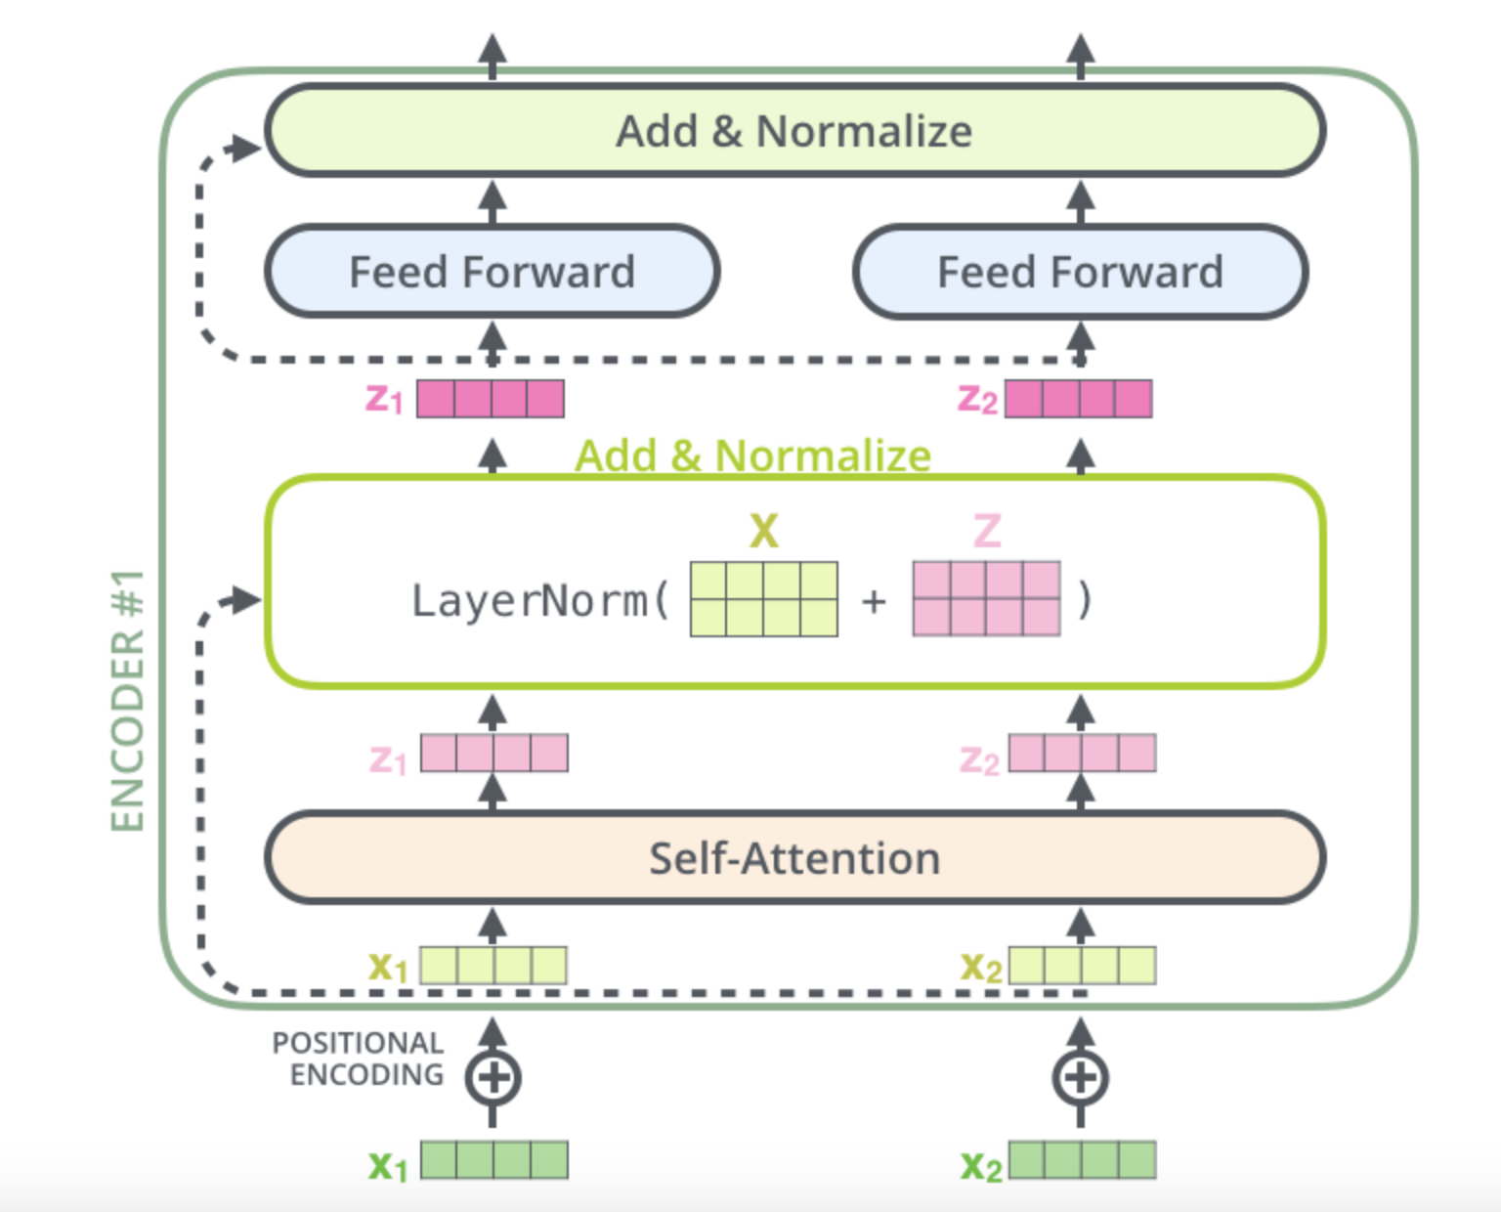

Slide 49
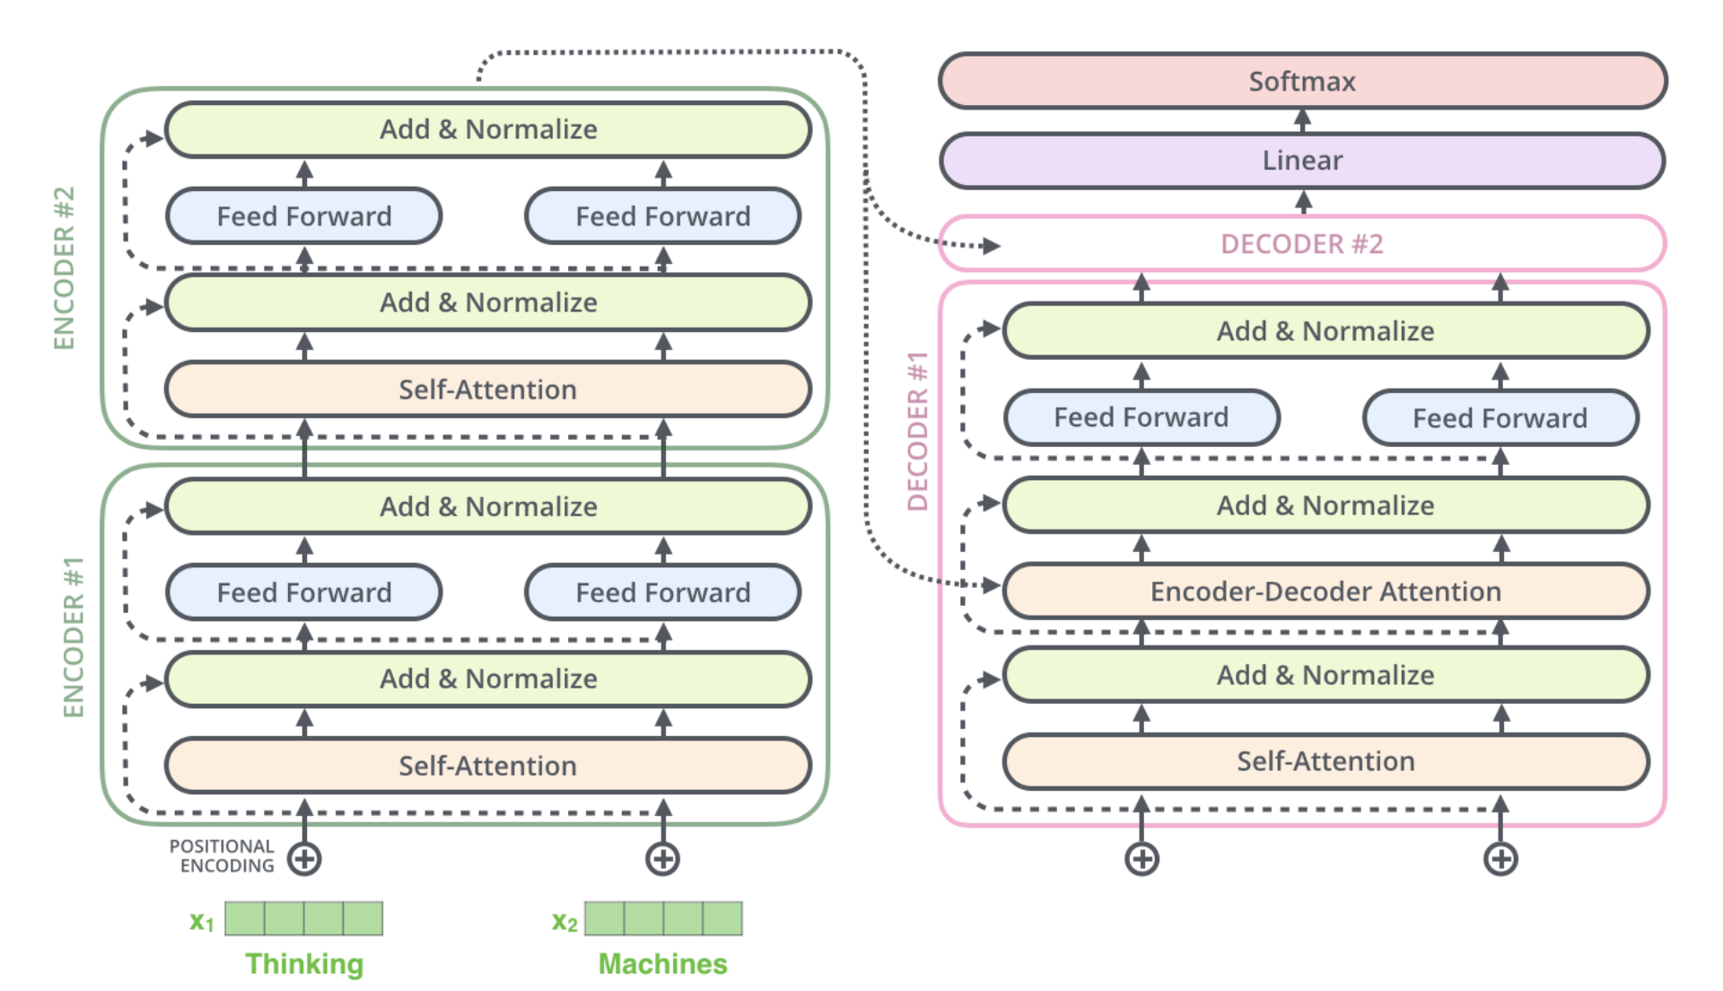

Slide 50
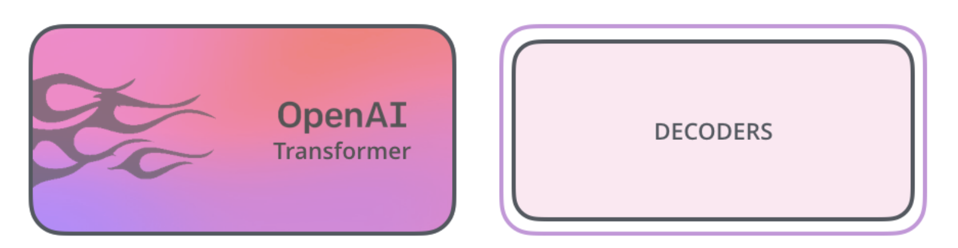

Slide 51
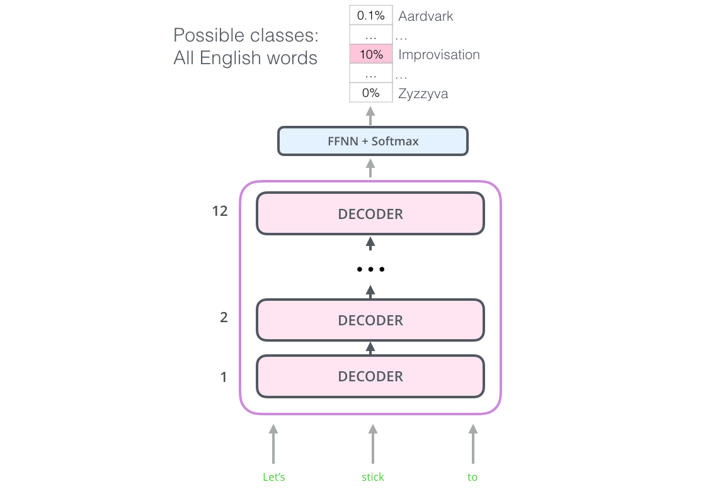

Slide 52
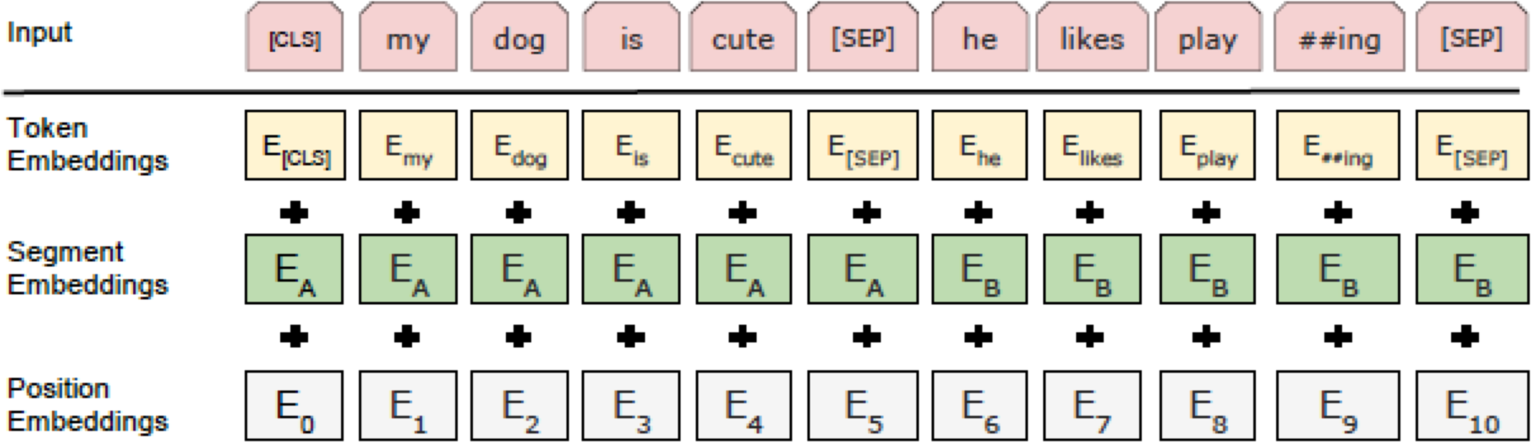
Input Representation
Token Embeddings: Use pretrained WordPiece embeddings
Position Embeddings: Use learned Position Embeddings
Jonas Gehring, Michael Auli, David Grangier, Denis Yarats, and Yann N. Dauphin. Convolutionalsequence to sequence learning. arXiv preprint arXiv:1705.03122v2, 2017.
Added sentence embedding to every tokens of each sentence
Use [CLS] for the classification tasks
Separate sentences by using a special token [SEP]

Slide 53
Task#1: Masked LM
15% of the words are masked at random
and the task is to predict the masked words based on its left and right context
Not all tokens were masked in the same way (example sentence “My dog is hairy”)
80% were replaced by the <MASK> token: “My dog is
<MASK>”
10% were replaced by a random token: “My dog is apple”
10% were left intact: “My dog is hairy”

Slide 54
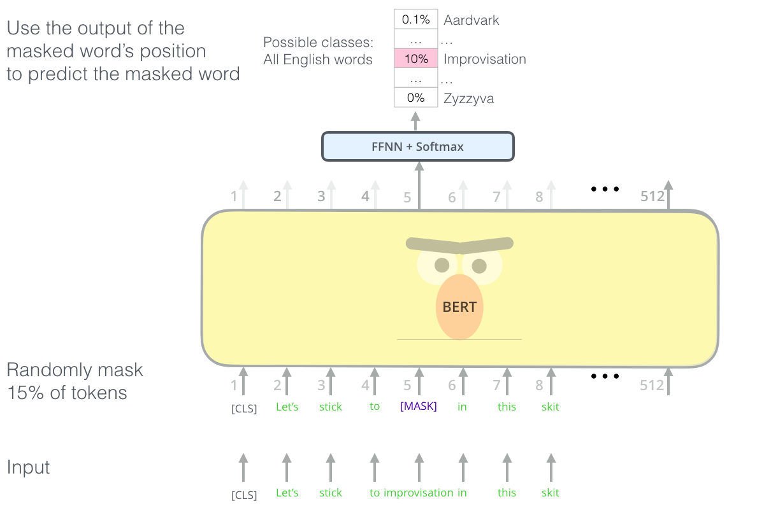

Slide 55
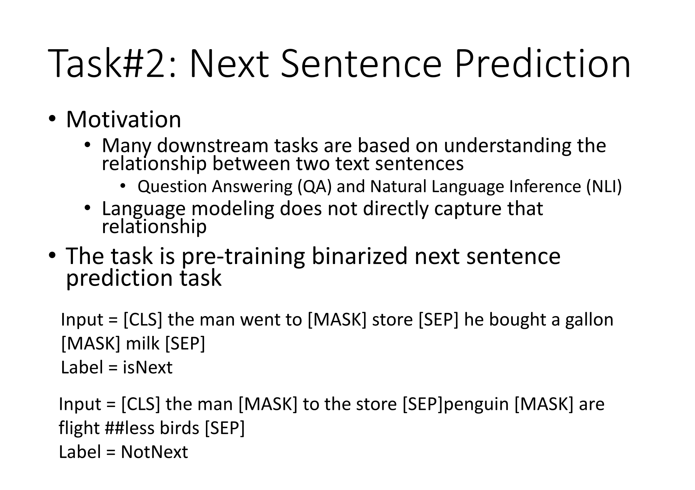

Slide 56
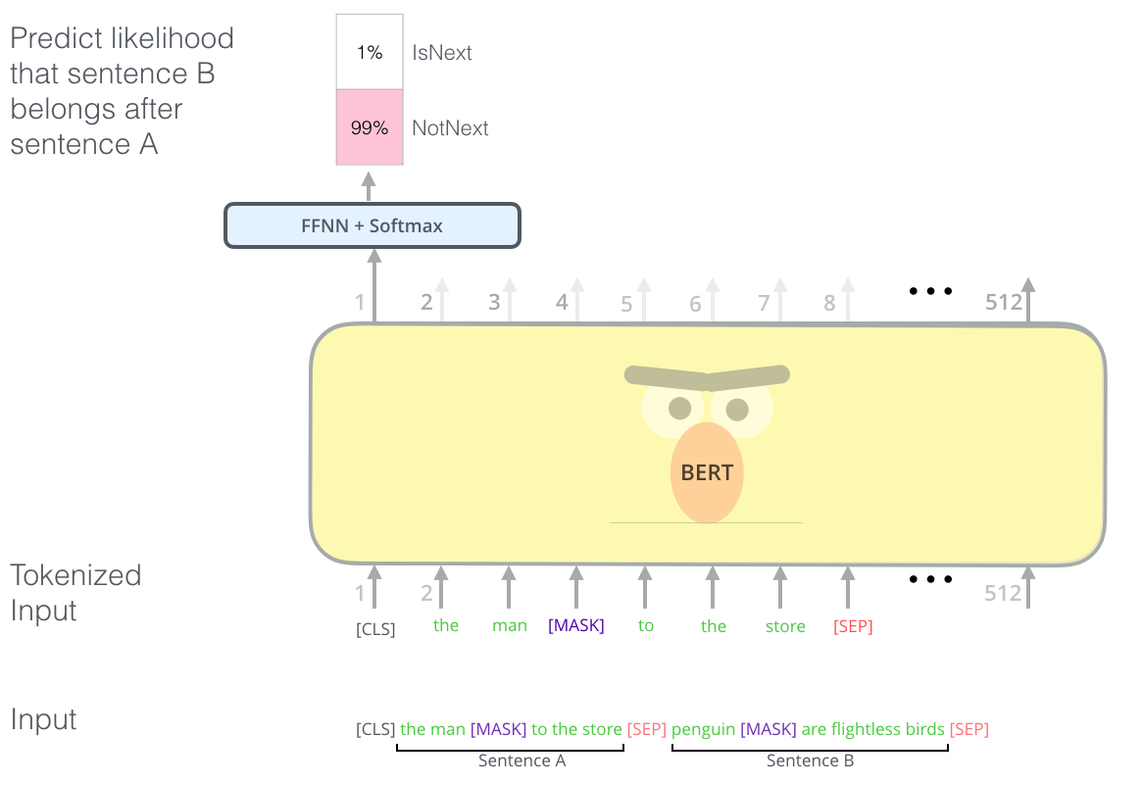

Slide 57
Pre-training procedure
Training data: BooksCorpus (800M words) + English Wikipedia (2,500M words)
To generate each training input sequences: sample two spans of text (A and B) from the corpus
The combined length is ≤ 500 tokens
50% B is the actual next sentence that follows A and 50% of the time it is a random sentence from the corpus
The training loss is the sum of the mean masked LM likelihood and the mean next sentence prediction likelihood

Slide 58
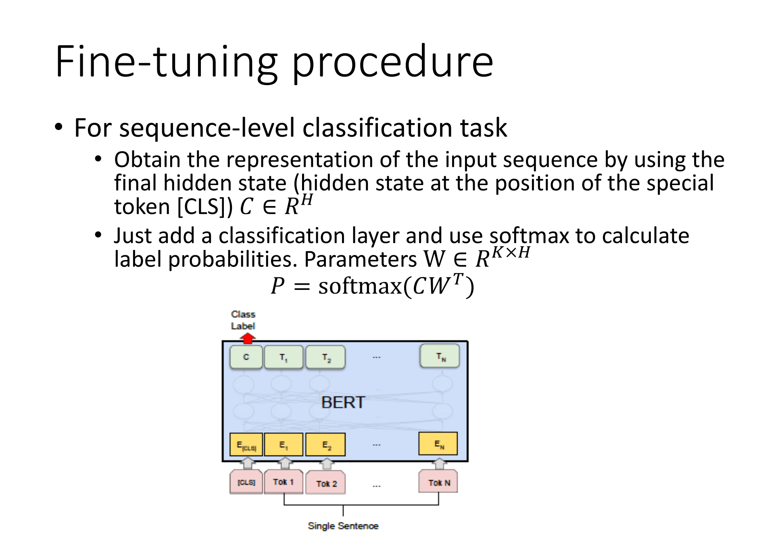

Slide 59
Fine-tuning procedure
For sequence-level classification task
All of the parameters of BERT and W are fine-tuned jointly
Most model hyperparameters are the same as in pre-training
except the batch size, learning rate, and number of training epochs

Slide 60
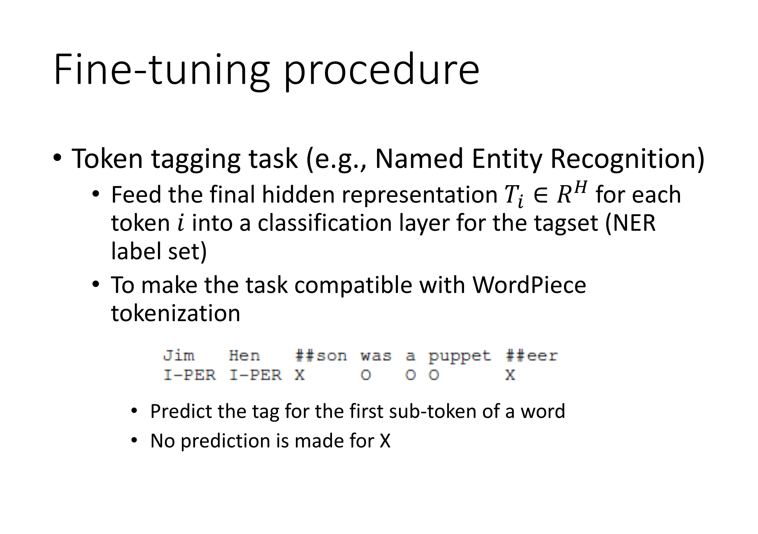

Slide 61
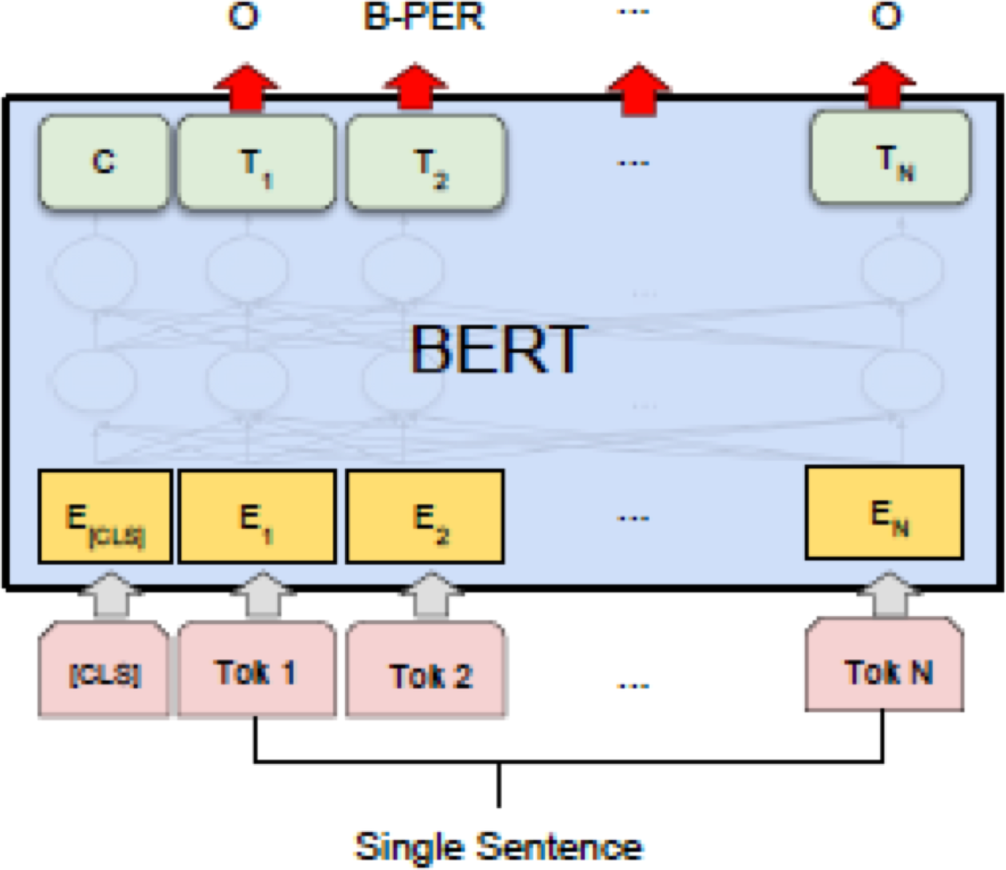
Fine-tuning procedure
Single Sentence Tagging Tasks: CoNLL-2003 NER

Slide 62
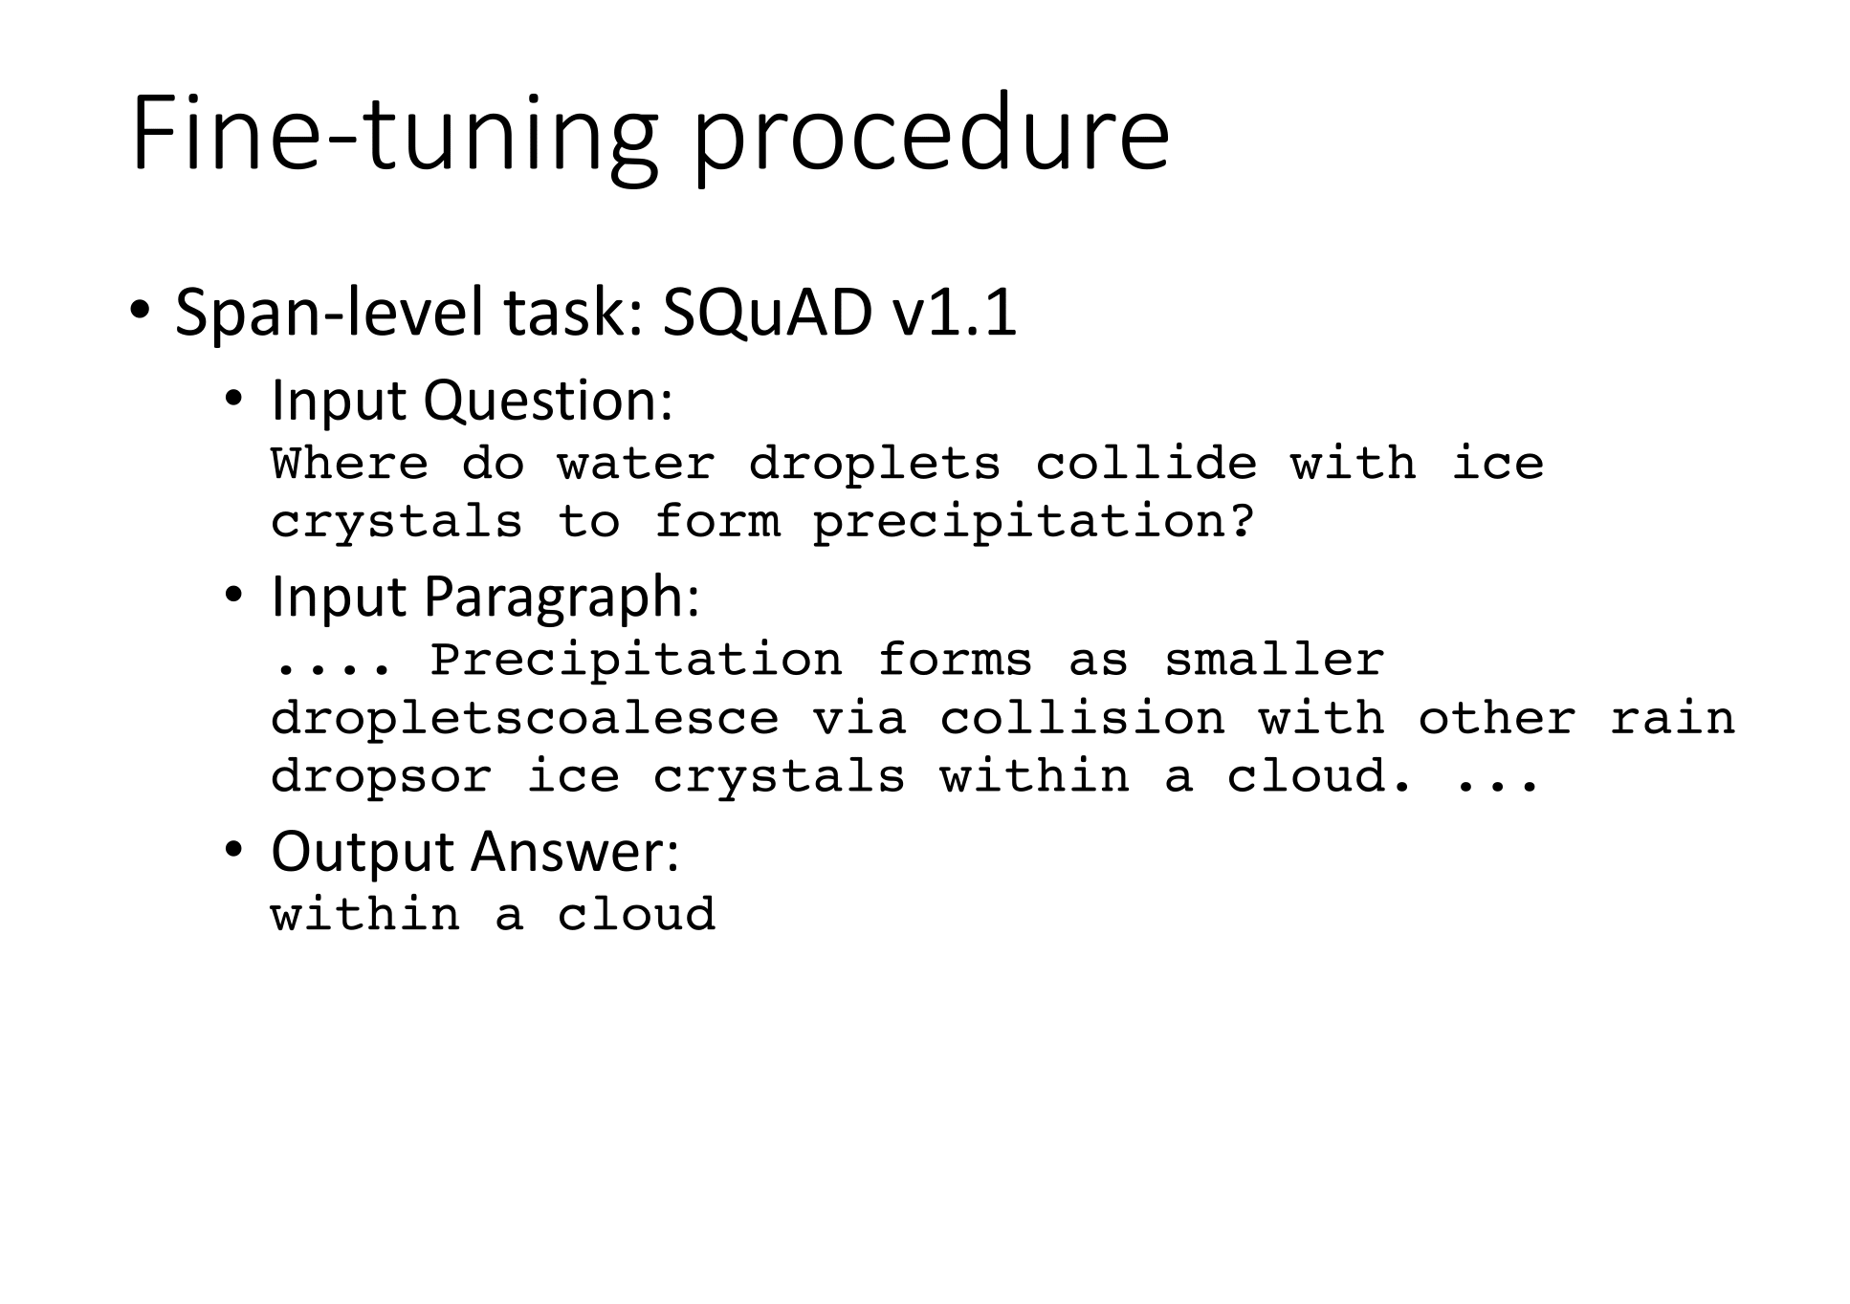

Slide 63
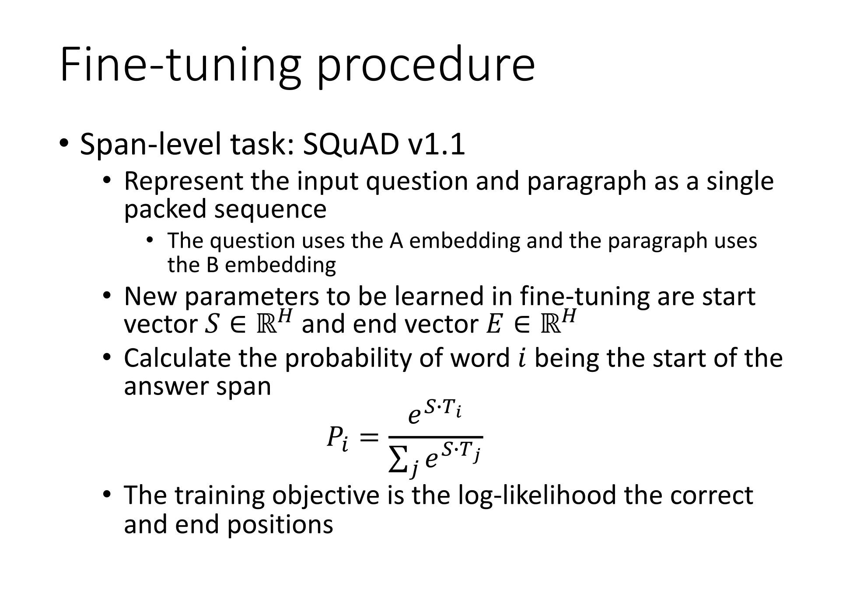

Slide 64
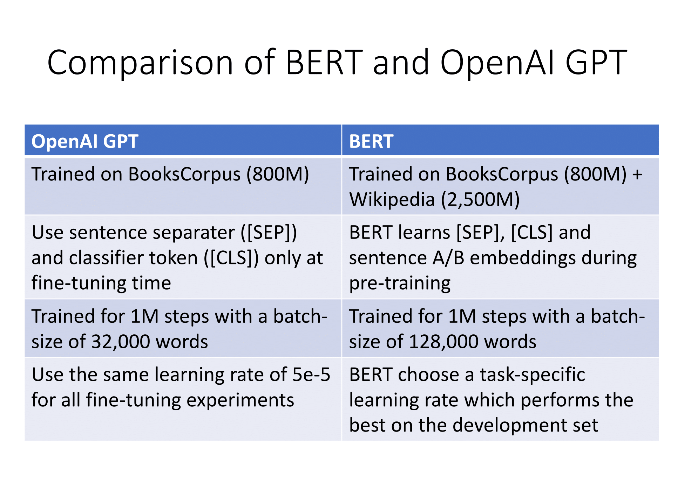

Slide 65
Outline
Research context
Main ideas
BERT
Experiments
Conclusions

Slide 66
Experiments
GLUE (General Language Understanding Evaluation)
benchmark
Distribute canonical Train, Dev and Test splits
Labels for Test set are not provided
Datasets in GLUE:
MNLI: Multi-Genre Natural Language Inference
QQP: Quora Question Pairs
QNLI: Question Natural Language Inference
SST-2: Stanford Sentiment Treebank
CoLA: The corpus of Linguistic Acceptability
STS-B: The Semantic Textual Similarity Benchmark
MRPC: Microsoft Research Paraphrase Corpus
RTE: Recognizing Textual Entailment
WNLI: Winograd NLI

Slide 67
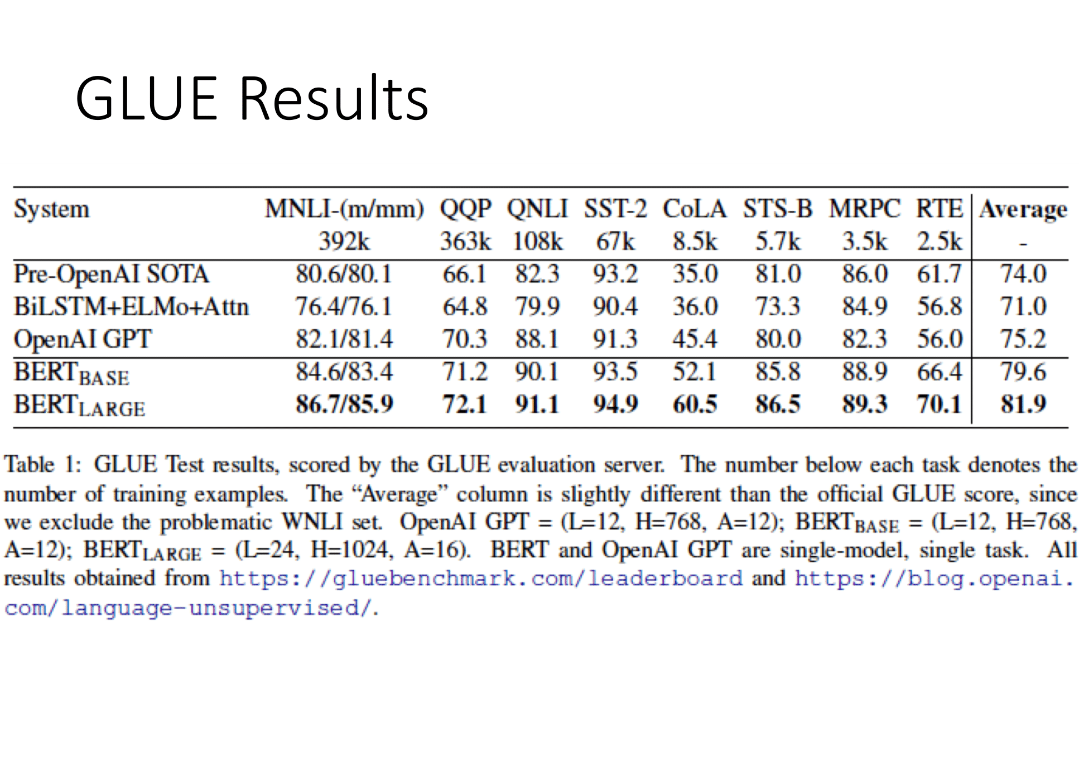

Slide 68


Slide 69


Slide 70


Slide 71


Slide 72
Ablation Studies
To understand
Effect of Pre-training Tasks
Effect of model sizes
Effect of number of training steps
Feature-based approach with BERT

Slide 73


Slide 74


Slide 75
Conclusions
Unsupervised pre-training (pre-training language model) is increasingly adopted in many NLP tasks
Major contribution of the paper is to propose a deep bidirectional architecture from Transformer
Advance state-of-the-art for many important NLP tasks

Slide 76
Links
TensorFlow code and pre-trained models for BERT: https://github.com/google-research/bert
PyTorch Pretrained Bert: https://github.com/huggingface/pytorch-pretrained-BERT
BERT-pytorch: https://github.com/codertimo/BERT-pytorch
BERT-keras: https://github.com/Separius/BERT-keras

Slide 77
Remark: Applying BERT for non- English languages
Pre-trained BERT models are provided for more than 100 languages (including Vietnamese)
https://github.com/google- research/bert/blob/master/multilingual.md
Be careful with tokenization!!
For Japanese (and Chinese): “spaces were added around every character in the CJI Unicode rage before applying WordPiece” => Not a good way to do
Use SentencePiece: https://github.com/google/sentencepiece
We may need to pre-train BERT model

Slide 78
References
Devlin, J., Chang, M. W., Lee, K., & Toutanova, K. (2018). BERT: Pre-training of Deep Bidirectional Transformers for Language Understanding. arXiv preprint arXiv:1810.04805.​
Vaswani et al. (2017). Attention Is All You Need. arXiv preprint arXiv:1706.03762. https://arxiv.org/abs/1706.03762​
The Annotated Transformer: http://nlp.seas.harvard.edu/2018/04/03/attention.html, by harvardnlp.​
The Illustrated Transformer: http://jalammar.github.io/illustrated-transformer/
ELMo explained: https://www.mihaileric.com/posts/deep-contextualized-word-representations-elmo/
ULMFit explained: https://yashuseth.blog/2018/06/17/understanding-universal-language-model-fine-tuning-ulmfit/
Dissecting BERT: https://medium.com/dissecting-bert​
The Illustrated BERT, ELMo, and co. (How NLP Cracked Transfer Learning): http://jalammar.github.io/illustrated-bert/

